Slide 1
COA Lab Project (2016-2017) The LNMIIT, Jaipur
Fire Emergency System
Bhavin Agarwal(15UCS033)
Devendra Samatia (15UCS037)
Divyanshu Jhawar(15UCS040)

Slide 2
Introduction
We are designing an Instruction Set Architecture for a 16-bit machine for Fire Control System for a multi storey building which can handle various situations.
Contents of project:
Functions
Memory Model
Registers
Instruction Format
Instruction Design
Data Types
Addressing Modes
Instruction Types
Control Flow

Slide 3
Functions
GatesControl() : This function control the gates of which gates to close and which to close at the time of emergency.
FaultHandler() : This function provides in which zone of the building the fault happened and how severe the fire. It uses the smoke and temperature detector which provides the details of room/area.
RecallElevator() : It recalls the elevator to a safe floor away from the affected zone of the building. It works on the information provided by FaultIndicator function.
PowerController() : This function shut down all the power sources that can further increase the effect of fire. The information of risky power sources are already provided to the system.
EmergencyCall() : As soon as the fault indicator confirms tha fault an automatic call and information regarding the location is sent to the rescue team .

Slide 4
Functions
PathIndicator() : This function turn on the emergency lights which shows the exit path to the people struck in the building and opens all the ventilator in the affected area.
WaterEjector() : It ejects the water in the affected area according to the severeness of the fire.
Co₂Ejector() : It ejects the water in the affected area according to the severeness of the fire.
Alarm() : This Function buzzes the alarm and aware the other people in the building.
EmergencyActivator() : After the confirmation of fault detector this function controls the other function.
Display ( ) : This function displays the temperature and CO2 level of the room.
DetectorMaintainence() : It checks whether levels of CO2 and water are enough or not for the case of emergency.

Slide 5
Memory Model
We will be using 16–bit memory for the working of our Fire Emergency System. So, the word will be of 2 bytes and 2 bytes will be used at a time to store an instruction
We are using an aligned memory model for our machine.
We have big endian memory arrangement.

Slide 6
Memory Model
Gates Control Stack
Zonal Queue
N-Ary tree of Zones
Hash Table of floor equipments

Slide 7
SPECIAL PURPOSE REGISTERS
Registers
Alarm Register (R21)
Elevator Register (R22)
Indicator Register (R23)
Smoke Register (R24)
Temperature Register (R25)
Zone Register (R26)
Valve Register(R27)
Instruction Register (IR)
Stack Pointer(SP)
Status Flag Register (OV,Z,N)
Program Counter (PC)

Slide 8
Registers
GENERAL PURPOSE REGISTERS
21 general purpose registers. (R00-R20)

Slide 9
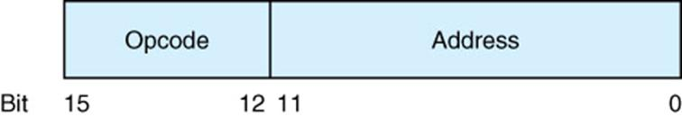
Instruction Format
Zero Address Instructions: START, ALARM,MSF,RET,HLT, LABLE
One Address Instructions: PTI,JMP,JNE,JLE,JGE,POP, CLE, ELEV,ON,OFF,GAT,PSH
Two Address Instructions: MOV, ADD, SUB,CMP, FLOW,STORE,LOAD
Three Address Instruction :DSP

Slide 10
Instruction Design
DSP: 0 ZZZZZ TTTTT CCCCC (Register)
MOV: 100000 XXXXX YYYYY (Register)
ADD: 100001 XXXXX YYYYY (Register, Register)
SUB: 100010 XXXXX YYYYY (Register, Register)
CMP: 100011 XXXXX YYYYY (Immediate, Register)
FLOW: 100100 XXXXX YYYYY (Register, Direct)
STORE: 100101 XXXXX XXXXX (Register, Indirect)
LOAD: 101010 XXXXX YYYYY (Indirect, Register)
LOAD1: 101011 XXXXX YYYYY (Immediate, Register)
PTI: 11000000000 XXXXX (Register)
JMP: 11000000001 XXXXX (Immediate /LABEL)
JNE: 11000000010 XXXXX (Immediate /LABEL)
JLE: 11000000011 XXXXX (Immediate /LABEL)
JGE: 11000000100 XXXXX (Immediate /LABEL)

Slide 11
Instruction Design
POP: 11000000101 XXXXX (Register)
PSH: 11000000110 YYYYY (Register)
CLE: 11000000111 XXXXX (Direct)
ELEV: 11000001000 XXXXX (Register)
ON: 11000001001 XXXXX (Register)
GAT: 11000001011 XXXXX (Register)
START: 1110000000000001
ALARM: 1110000000000010
HLT: 1110000000000110

Slide 12
Instruction Types
Data Transfer Instruction: MOV,LOAD,STORE,PSH,POP,ELEV, ON, OFF, GAT
Control Transfer Instruction: JMP,JGE,JLE,JNE,LABEL,FLOW
Comparison Instruction: CMP
Arithmetic Instruction: ADD,SUB,START
I/O Instruction: DSP, CLE, START, ALARM

Slide 13
Data Types
From numeric and non numeric data types we will be using only Numeric Data types.
Numeric data types will be of integer type signed 16 bit value.
We will be using 2’s compliment will be used to store negative values.
We will be using Most Significant Bit for a signed bit.

Slide 14
Control Flow
Control flow of our instructions are handled by MSF and RET statement. Instructions are fetched from consecutive memory locations. Procedure call will be made for Emergency Indicator, which is maintains the other functions.
MSF will transfer the address of instruction to top of stack and RET statement transfers the procedure call to the memory location present at the top of stack.

Slide 15
Control Flow​
Fault Handler
Display
Emergency Activator
Call Emergency Number
Gates Control
Recall Elevator
Power Controller
Path Indicator
Water and CO₂ Ejector
Alarm

Slide 16
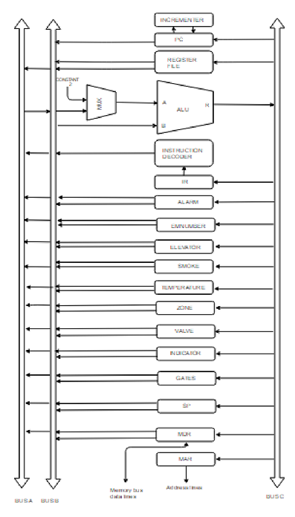
Datapath
(multi-level implementation)

Slide 17
ALU Design​

Slide 18
Control Unit​
PCout , R=B , MARin , Read , IncPC
WMFC
MDRoutB , R=B , IRin
Branch to starting address of appropriate microroutine
Add R4 , R5:

